Slide 1

Angular
Design, Philosophy, Way Of Life
Now annotated with notes!
Notes:
While this slide is up, discuss first interactions with the framework, and the things which got me interested in the first place. These should be relevant for other developers dealing with the same problems. To give a quick re-cap of this story, it goes something like this: Basically, I’d had my first interactions with angular a little over a year ago (at the time of this writing, but really late 2012, early 2013). I was on a team working on a prototype application for Sightline Innovation, as a student. The project can be seen at https://github.com/rawkamatic/LinuxLock, and https://github.com/caitp/linux-lock-pi respectively. As I say during the talk, most of the work I’d done on this was for the embedded code (we were talking to RFID readers over a serial port on a Raspberry Pi, in Node.js, of all things! If we’d waited, could have used http://www.espruino.com/ or similar!), as well as the web service. Admittedly, I probably had a lot more fun working on the non-frontend stuff, but just the same, I really liked the frontend approach that was taken, and found it pretty easy to understand. So, I started taking on freelance contracts using AngularJS, and trying to use it in some of my own hobby projects as well. It left a really good impression on me, so I began to dig into the code, submit patches, and began reviewing other peoples patches. All in all it just seemed like the right thing to do, given that I’d been working on Mozilla projects, and had code checked into NetSurf and Chromium and a number of other open source projects already, so I was pretty at home contributing to this stuff. But that’s not really the important part of this story, the important part is “Why is Angular awesome, what turned me onto it, why should it turn you on too?” And the answer to those questions are many. One, the routing implementation. I had experience with PJAX routing, I made an attempt to use it in a rails blog I had a few years ago. It was a nightmare, it was overly complicated, it was hard to follow what was going on. Angular just took this whole process, and made it super easy. Another thing, was the ease of creating custom elements. I _LOVED_ this. I came from doing native programming, where this was always a thing to do, whether it be custom widgets using the Win32 API, or a custom Qt element, or whatever, encapsulation and customization were things you could do. But this had always been much harder on the web, often looking like messy div-soups. So I loved the way angular made this stuff simple. I didn’t do a lot of this for this project, but I found it incredibly easy to integrate the jQuery UI datepicker using like, 5 lines of code or something, and this was just awesome. Third, the form validation stuff. NgModel is just so flexible, and much easier (in my opinion) to work with than native HTML5 constraint validation, not to mention it supports more browsers, and you could write custom attributes for doing this stuff which would make it look much more semantic and understandable. This is huge! There are so many other areas where Angular just made life /better/, it’s hard to get into all of it, but there is stuff here to offer literally any front-end developer. It’s a big deal. Anyways, I could go on for hours about this stuff, but lets carry on with the (what I consider to be) the PRIMARY concerns of AngularJS --- There are definitely a lot of other concerns, but these are the big ones, in my view.

Slide 2
Primary Concerns

Slide 3
Primary Concerns
Growing the language of HTML
Notes:
Directives as a pre-cursor to Web Components / Custom Elements, making HTML “do more”. I got into a not-bad side track about what this really “means” for the web, because this custom element stuff is a relatively new thing. I think I mentioned that Igor suggested watching Guy Steele’s talk about this stuff, which is actually pretty good, and can be seen at https://www.youtube.com/watch?v=_ahvzDzKdB0. So basically Angular is enabling you to create custom elements, or add behaviour to elements using attributes or classes. This isn’t quite as elegant as Polymer (and Web Components) ways of implementing this stuff, but it’s really cool, and really enables an application to do a lot, while keeping the markup relatively simple.

Slide 4
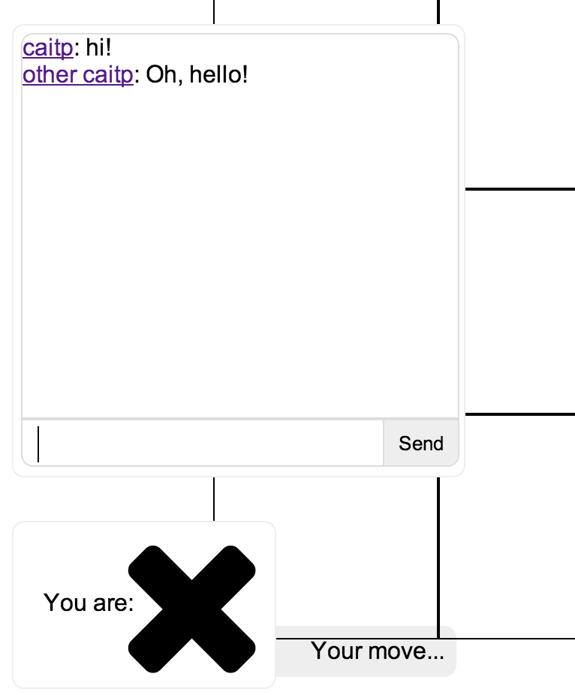
Primary Concerns
Growing the language of HTML
<ttt-game-waiting></ttt-game-waiting> <ttt-game-end-dialog></ttt-game-end-dialog> <ttt-player-marker></ttt-player-marker> <ttt-game-chat></ttt-game-chat>

Slide 5
Primary Concerns
Declaratively express the application
Notes:
As a side-note, “Declaratively express the application” was either Igor or Misko’s words, but I like them so I’m shamelessly using them here as though I came up with them myself. It’s a great and clear way to say it. This is related to the previous point, but I consider it slightly different, because we’re talking about functional behaviour of the application being described declaratively, rather than “components”. So, things like “instantiate my controller and create a new scope for this element and its children”, or “repeat this element for each item in a collection”, or “conditionally show this element”, or “conditionally add classes to this element”, all with extremely simple declarative expressions. This isn’t really “business logic” (although, form validation rules might be), but it really simplifies the app and shrinks LOC significantly. Also, it’s very easy to read. Now, I wanted to get into filters and Angular expressions here, and stupidly I did not. I kind of want to create a new slide which covers these on their own, because questions were asked about these. Oops! At any rate, expressions in Angular are a sort of subset of javascript, evaluated in a specific context (which is typically a scope). There are also interpolation expressions, which effectively return the expression’s result converted to a string. Expressions also extend JS (so they’re a bit of a superset, as well) due to the presence of filters. Filters are basically ways to transform an expression, and these are super cool. Check out Sharon DiOrio’s talk on filters from ngConf2014, http://youtu.be/L4FJ_kuO9Rc, which gets into this in some good detail, has a cool demo, and is presented much better than my talk.

Slide 6
Primary Concerns
Declaratively express the application
<div class="ttt-chat-messages"> <p ng-repeat="msg in $game.messages" ng-class="msg.type"> <a ng-click="showProfile(msg.marker)">{{msg.name}}</a>:
{{msg.message}} </p> </div>

Slide 7
Primary Concerns
Declaratively express the application
<ttt-profile ng-show="$board.state==='profile'"> </ttt-profile> <ttt-game ng-show="$board.state==='game'"> </ttt-game>

Slide 8
Primary Concerns
Focus on testable code
Notes:
Brief explanation on how Angular enables and encourages testable code, particularly the benefits of the IOC style of working --- Examples of this (though not within an Angular app’s context) are shown in demo code

Slide 9
Primary Concerns
Focus on testable code
- Dependency Injection
- Karma - Simple test runner
- Protractor - Selenium/Angular integration

Slide 10
The Future

Slide 11
The Future
Mobile First
Notes:
May not have explained this very clearly… Mainly talking about A) improving performance, which also benefits desktop users, but also talking about improved support for mobile UIs via modules, among other things. It’s sort of up in the air right now, though.

Slide 12

The Future
Harder
Better
Faster
Stronger
Notes:
It’s tacky, I know! But talking about “harder” and “better” as in durability, ease of debugging (using things like Zone.js) and benchmarking tools --- “faster” and “stronger” as in the focus on improved performance --- But really this is just an excuse to use a pointless graphic, oh well! I went into some detail regarding each of these points, but yeah, this is a case where the best thing to do is check out the design docs, as well as the existing projects implementing this stuff.

Slide 13
The Future
Emerging web standards
Notes:
ES6 and Web Components each really deserve their own completely separate talks, it turns out that people weren’t very acquainted with (particularly) Web Components, so I gave a bit of an introduction to that and an explanation about the encapsulation and reusability that they are meant to enable. There is a lot of great info regarding both of these at resources like http://www.polymer-project.org/, http://www.w3.org/TR/components-intro/, http://www.x-tags.org/, and others.

Slide 14
The Future
Emerging web standards
- Web Components
- ECMAScript 6

Slide 15
FIN
Materials
https://github.com/caitp/tictactoe.io
https://github.com/caitp/tictactoe.js
Notes:
Q&A time! I think this was the longest Q&A session out of all of the talks at jQueryTO, which is good and bad. So, as a quick re-cap of the questions which were asked (if I can remember them correctly): 1) What is transclusion? My answer was more of an example of transclusion, using a more modern web components style, as opposed to Angular’s directive API. However, my answer basically ways to position child content into a different document’s context. It’s hard to explain this textually, so a visual representation would be the best bet. Wikipedia has a simple explanation of this at http://en.wikipedia.org/wiki/File:Transclusion_simple.svg. Unfortunately, I didn’t get into the sort of “special transclusion” types in Angular, but I think it would have just confused people even more. Shoot me an email or find me on IRC if you want to ask specific questions about transclusion in AngularJS 1.x 2) What is the Shadow DOM? Admittedly, I should have realized that this would be something which wasn’t well understood by most of the developers present. I sort of branched off to talk about this, from both an Angular and Web Components perspective, describing the kinds of encapsulation benefits you get from this. However, I didn’t have very much time, and there is a lot of things I’ve omitted talking about, including things like event re-targetting, shadow piercing selectors, the fact that shadow root nodes don’t technically have a “parent” element (but only an associated “host” element), but I’ve linked to good resources on this stuff, including http://www.w3.org/TR/components-intro/ and http://w3c.github.io/webcomponents/spec/shadow/ 3) Change detection --- How does it work? Why can it sometimes be pathologically bad? This is a great question, and probably a great time to plug the work on Angular.dart and the JS port of the change detection code at watchtower.js. Basically, in Angular 1.x, the dirty checking algorithm does a sort of works top-down, checking out each watched property/expression/function call, comparing it to its last value, and running a listener function if the value changes. Reasons why this can be expensive: certain portions of the algorithm can create a lot of garbage (such as the $watchCollection algorithm, which makes a totally new copy of any collection), calling listener functions while the CD algorithm is still running, in which the watched value may change, and require the evaluation of listeners to be repeated, etc. So, dirty checking is relatively simple in terms of what it does, but it can also be easy to cause problems with this, which is why it’s been examined and improved in Angular.dart, and Angular 2.0 Some other changes to the watching algorithms have been suggested and considered, including one-time binding and namespaced/shared watches, however it’s hard to promise whether either of these will be implemented and shipped. It could happen, though.
4) Routing in Angular: Is this something angular provides a means to do, compared with Ember which basically implements Rails routing client-side? I had actually wanted to cover all of this in my talk, it turns out I completely omitted the middle section of my talk about how Angular fits into the history of the web, and talks about Angular’s routing compared to things like PJAX routing systems and early AJAX systems which had been around before it. But, since I didn’t get to this in my talk, the answer is of course a resounding YES, this is one of the really cool things. Angular (using either ngRoute, ui-router, or one of the other router modules) makes client-side/SPA-style routing extremely easy, and in the case of ui-router, extremely dynamic. This is a good place to give an example, which was a part of my original planned talk but didn’t make it in. Compared with things like PJAX routing, all you need is a template, and a little configuration. From here, ngRoute (in particular) will fetch the template if it needs to, shove it into the ng-view element, compile its contents, and instantiate a controller for it. There’s no need to worry about things like whether or not the template should contain layout or not, as there often is with PJAX-style routing, so the system is much, much, much simpler. It also works with both HTML5 history API, and can also support browsers which do not have this, via hashbang urls. So this works extremely well. There were a lot of other great questions, I don’t have them all committed to memory, but if anyone wants to add to this list, leave a comment on the presentation, or tweet or something, I’m happy to provide answers, especially if I don’t really know the answer to your question myself. This is a good opportunity to research these things, as always.

